Slide 1

Image Filtering using Halide and a new Denoising Algorithm for Gradient-Domain Rendering
Bachelor thesis
Delio Vicini
Advisors: Prof. Dr. Matthias Zwicker, Marco Manzi

Slide 2
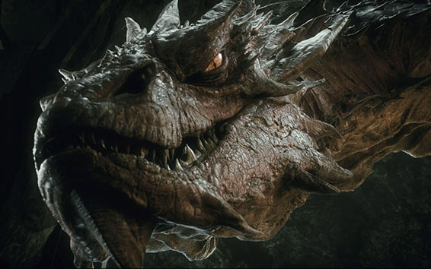
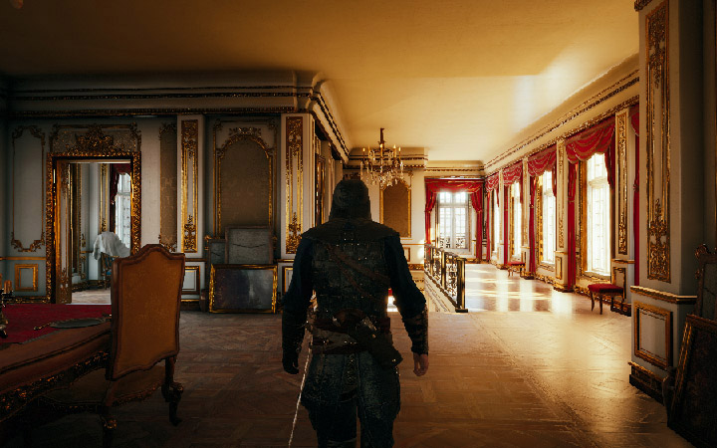
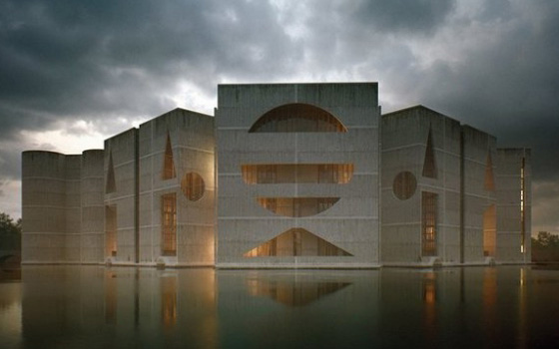
Motivation
Creating realistic images computationally
Many applications: Movies, games, visualizations, ...
«The Hobbit: The Desaulation of Smaug», Warner Bros. Pictures, 2013
«Assassins’s Creed Unity», Ubisoft, 2014
«The Third & The Seventh», Alex Roman, 2009
Notes:
My thesis is centered around the problem of creating realistic images computationally.
This has many applications, ranging from movies over games to architectural visualizations.

Slide 3
Monte Carlo Rendering
Requires simulating light transport
Monte Carlo rendering: evaluate many different light paths
➔ expensive!
Notes:
Rendering realistic images requires simulating how light is transported in a scene.
To get the physically correct image produced by the light in a scene, we can use Monte Carlo algorithms.
These algorithms essentially sample many random paths in a scene and record the amount of light carried along these paths.

Slide 4
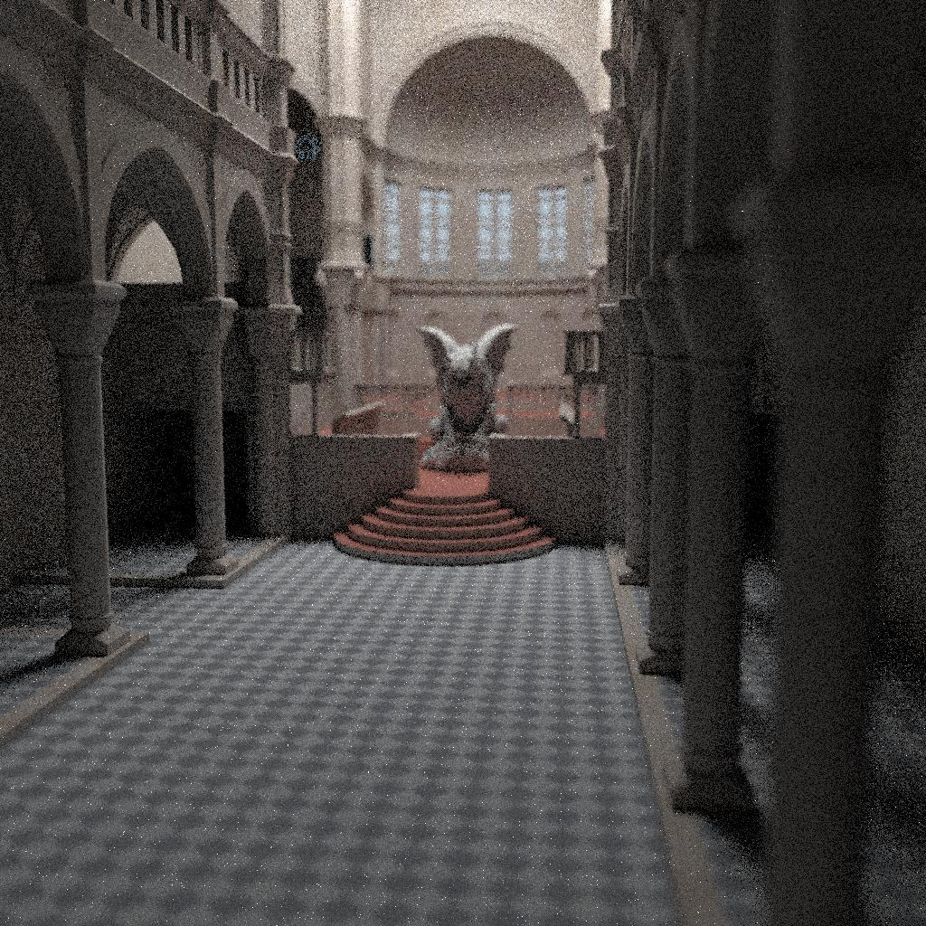
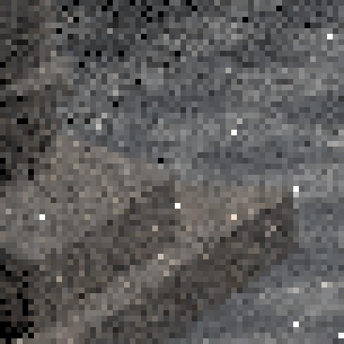
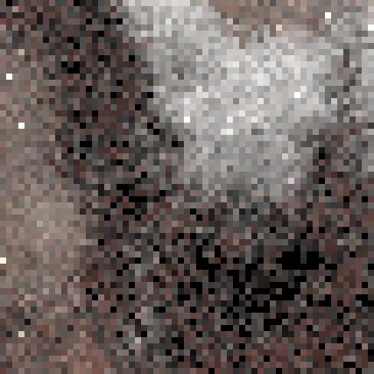
Monte Carlo Rendering
8 samples per pixel
≈17 s
Notes:
Convergence is very slow: the estimate is an unbiased estimated at each pixel, but exhibits significant variance.

Slide 5
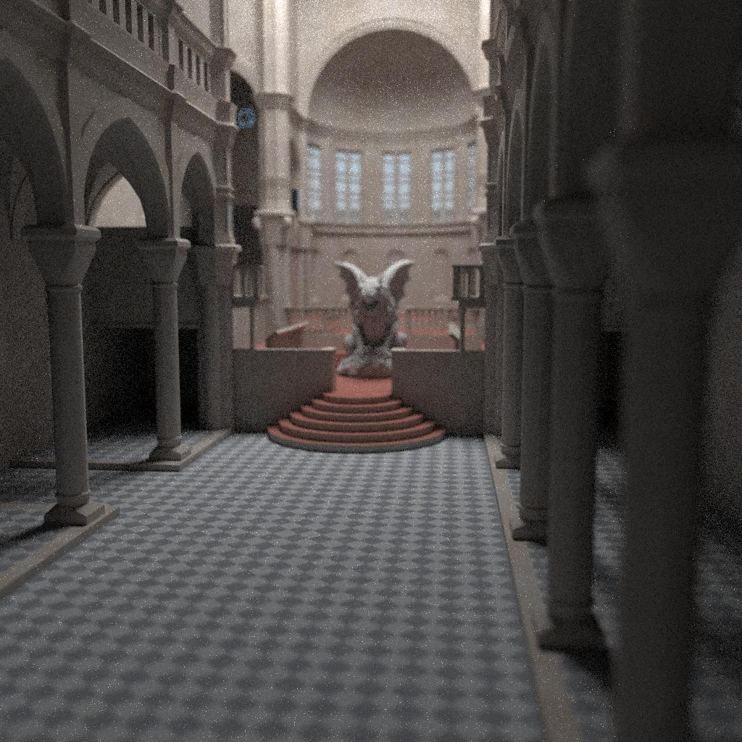
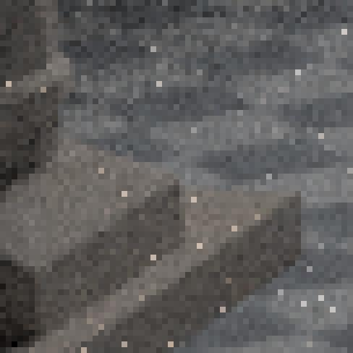
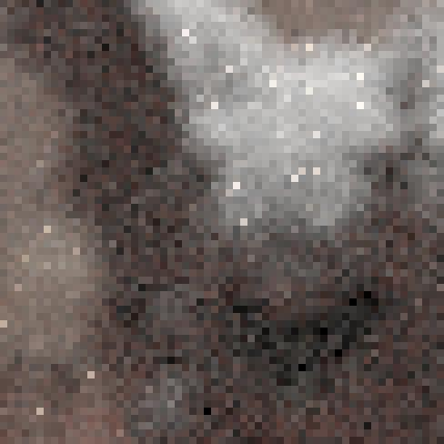
Monte Carlo Rendering
32 samples per pixel
≈1.1 min

Slide 6
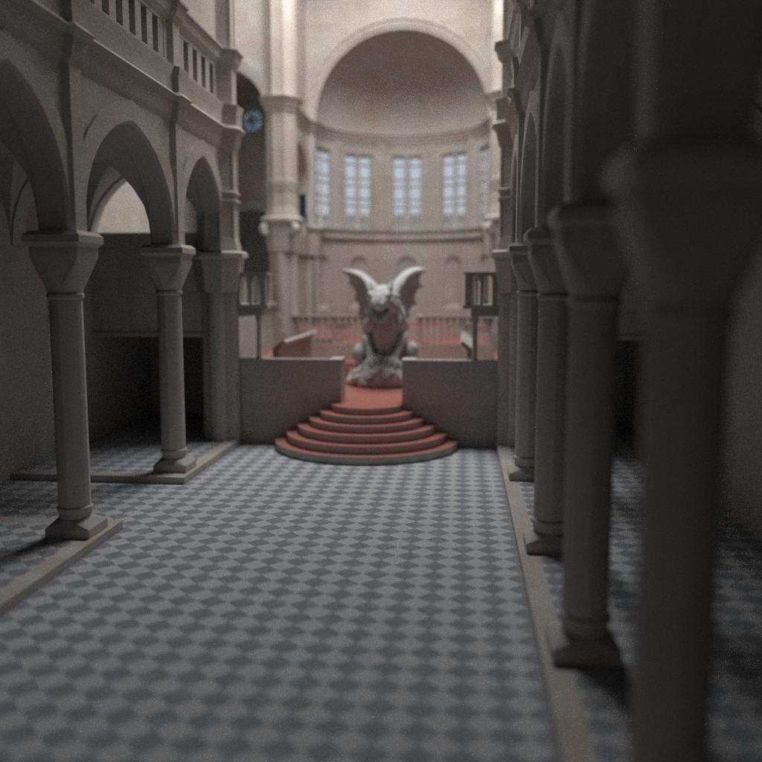
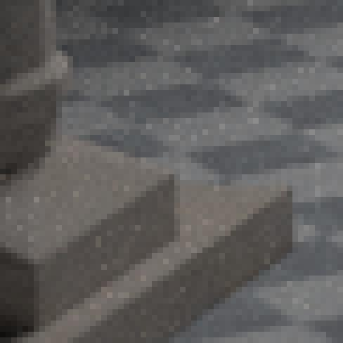
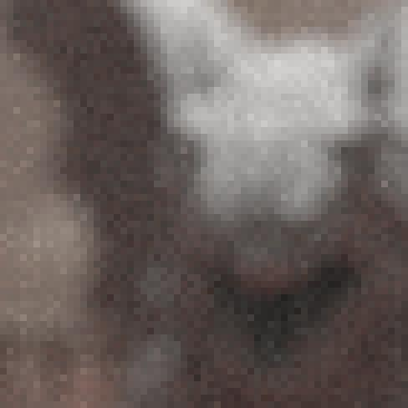
Monte Carlo Rendering
256 samples per pixel
≈9 min

Slide 7
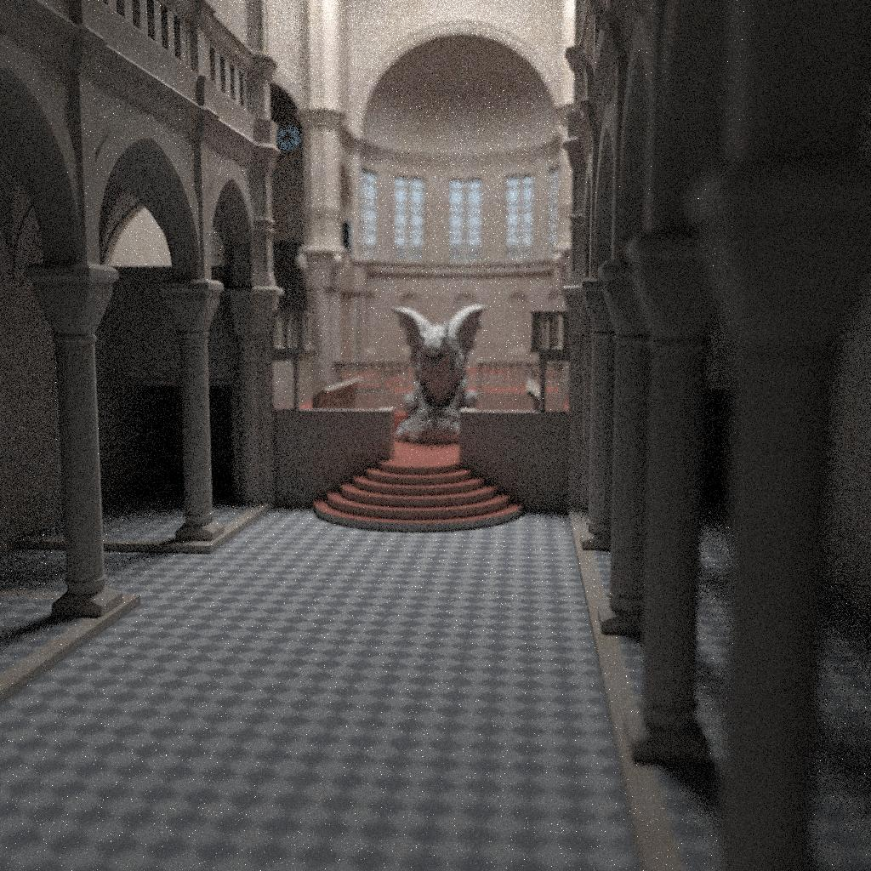
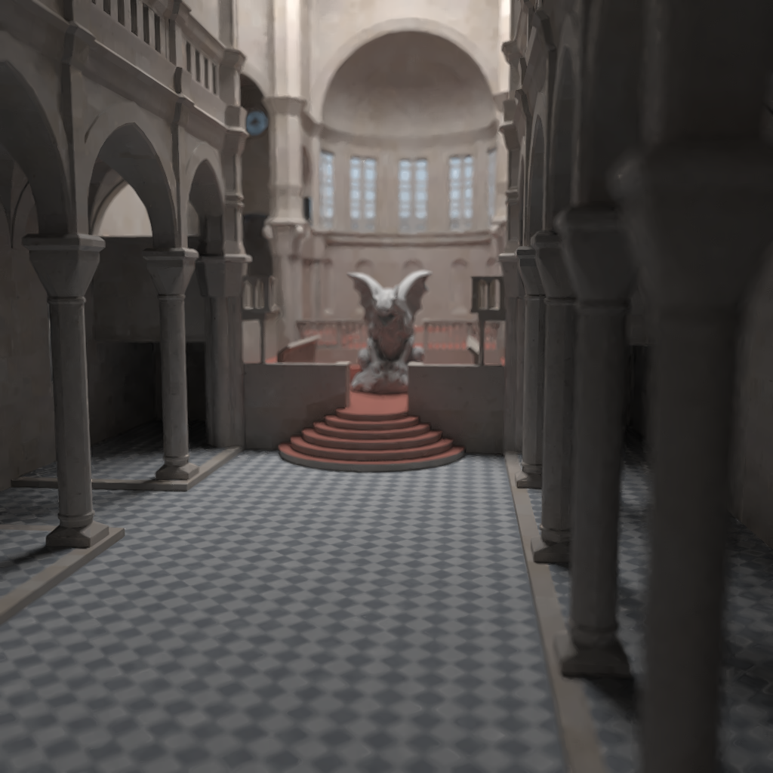
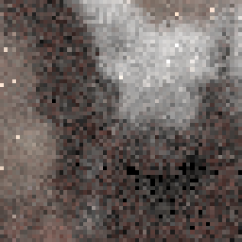
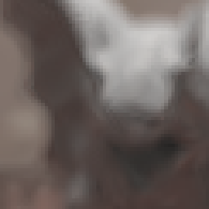
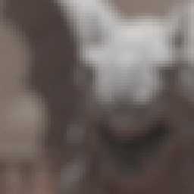
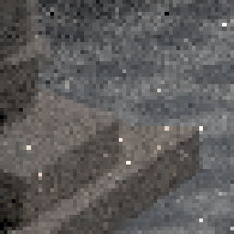
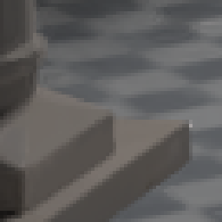
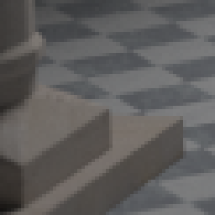
Denoising renderings
Noisy image
Filter result
Noisy image
Filter result
Reference
≈ 35 s
≈ 40 s
≈ 8.5 h
Notes:
Many many algorithms to reduce this variance or to somehow simplify the whole process. One approach that got a bit more popular in recent years is to first compute an unbiased Monte Carlo estimate and then filtering it.
The filtering adds bias, but reduces variance. Image is then closer to the reference image in terms of mean square error.
rMSE 1.3 * 10^-3

Slide 8
Content
Part I: Image Filtering using Halide
Part II: Denoising for Gradient-Domain Rendering

Slide 9
What is Halide? [Ragan-Kelley et al. 2013]
Domain-specific language for high-performance image processing
Why a special language for image processing?
Performance is important in image processing
Writing fast code is hard
Optimized code is difficult to read and maintain
Key idea: Separation of the algorithm from its schedule
Allows the programmer to optimize code efficiently
Not auto-optimization
Code can be targeted for different platforms (GPU, x86 CPU, ARM, ...)
Notes:
Halide is a domain specific language for image processing. Halide code is typically part of a larger c++ program and does only deal with image processing.
Motivation:
The main motiviation behind halide is to make it easier to write fast image processing code.
Many image processing algorithms require interactivity as the user may wants to tweak settings.
The speed of execution can often make the difference whether and algorithm is used in practise or not.
Writing fast code is hard and the resulting code is often hard to read and maintain.
Halide deals with these problems by separating the algorithm from its schedule. The specification of the functionality is seperated from how the algorithm is executed.
This prevents the programmer from accidentally modifying the functionality of the algorithm while optimizing.
It also allows to quickly explore different schedules without having to write a lot of code.
The sepearation of the schedule makes the code easier to read.
It’s about giving the programmer full control and not about auto-optimization.

Slide 10
Code example
3 x 3 box blur:
horizontal blur
vertical blur

Slide 11
Code example
Var x, y;
Func blurX, blurY;
// img: input image, loaded from file
blurX(x, y) = ( img(x - 1, y) + img(x, y) + img(x + 1, y)) / 3;
blurY(x, y) = (blurX(x, y - 1) + blurX(x, y) + blurX(x, y + 1)) / 3;
// Schedule
blurX.compute_root();
Notes:
Lets have a look at a small code example.
This example code computes a simple 3 x 3 box blur.
This means it first averages three horizontal values and then averages three vertical values.
First we need to declare the functions and variables we are going to use.
Halide follows a functional paradigm. You cannot manually write loops or conditions in Halide, everything is a function.
The function img is assumed to wrap access to an image and take care of boundary conditions
Then we define two functions blurX and blurY which compute our 3 x 3 box blur by averaging horizontally and then vertically.
If we were to execute the code like this, Halide would inline every function. This means we would effectively not have this separation into two passes.
To avoid this, we define a simple schedule.
By setting the function blurX to «compute_root», we essentially say that all values required from blurX should be computed before any are used.

Slide 12

Code example: simple schedule
blurX.compute_root();
Bounds inference: blurY needs blurX(x, -1)
img
blurX
blurY
Notes:
Visually this looks like this.
On the left we here have the input image.
Blur colors indicate reads, orange colors indicate write.
So we first compute each element of blurX by reading three horizontally adjacent values from img.
BlurY is then computed afterwards by reading 3 vertical neighbors from blurX.
This code and all the following code I will show runs on the CPU because its a bit easier to explain than code running on the GPU
TODO: TRY TO ACCELERATE THIS GIF HERE

Slide 13

Code example: parallelization
blurX.compute_root().parallel(y);
blurY.parallel(y);
img
blurX
blurY
Notes:
One way to speed up the code is by doing work in parallel.
The example image has now a slightly higher resolution to make it easier to see what happens.
Here, we parallelize over scanlines of the input.
This is obviously faster than the naive code, but this is still quite a bit from optimal.
A simple box blur is essentially not limited by computation power, but by memory access.
Using this schedule, we first load the original image from main memory, then compute blurX, store into main memory and then do the same thing agian for blur Y.
Todays CPU are quite good at caching things, but in this case, the result of blurX is most likely not in the cache anymore when used by blurY.

Slide 14
Code example: optimizing for locality
Var xo, yo, xi, yi;
blurY.tile(x, y, xo, yo, xi, yi, 64, 32).parallel(yo);
blurX.compute_at(blurY, yi).store_at(blurY, xo);
img
blurX
blurY
2 times faster than naive parallel code!
Notes:
One way to improve on the previous schedule is to compute the result of blurX close to when its needed.
In this new schedule, we first divide the input into tiles of 64 by 32 pixels.
The variables xo, yo then run over the indices of the tiles.
Xi and yi run over elements in the respective tile.
We then parallelize over yo.
This means, rows of tiles are processed in parallel.
We can then tell Halide, at which point we want to compute blurX more precisely.
Here we say we want it to be computed at each row of blurY.
This means, everytime we compute a row of blurY, we directly compute the not yet computed values of blurX.
With the store_at command we say at which level we want to store blurX.
Here, we want the buffer for blurX to be allocated for each tile.
In practice the buffer is reduced to a circular buffer.
We only need three rows of blurX at once.
While the previous schedule was something you could easily do in C++, this schedule would be much more work to implement.
Obviously you can implement this in raw C++, but it would be more timeconsuming.
Halide really allows to quickly explore these kind of scheduling ideas without committing to it.
If we schedule box blur like this: More than two times faster than the naive parallelization over y
Speedup of 3 times if the blur radius is increased.

Slide 15
Goals
How useful is Halide in practice?
We implemented using Halide:
Robust Denoising using Feature and Color Information (RDFC) [Rousselle et al. 2013]
Dual-Domain Image Denoising (DDID) [Knaus and Zwicker 2015]

Slide 16
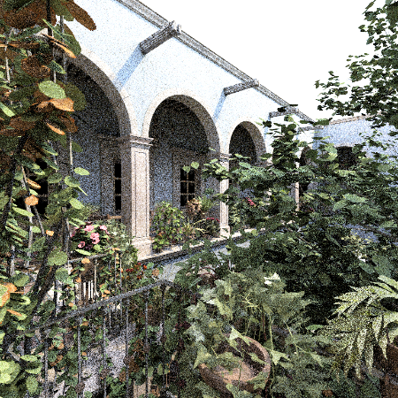
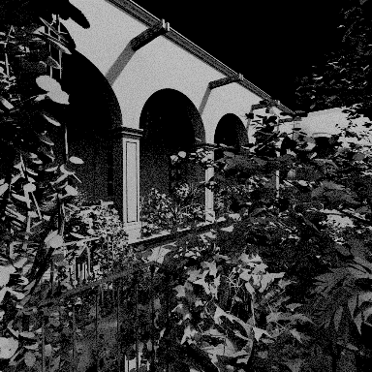
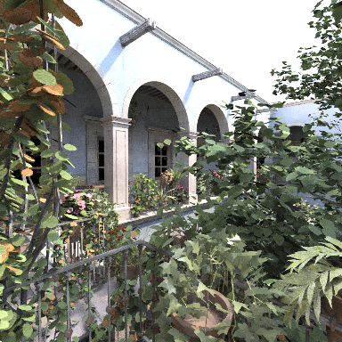
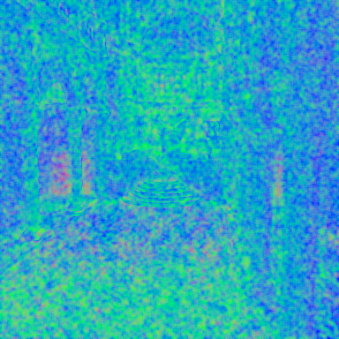
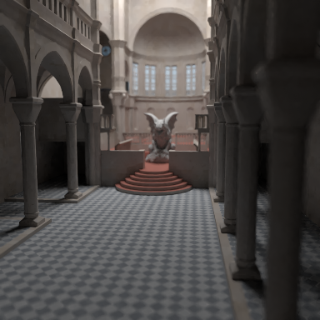
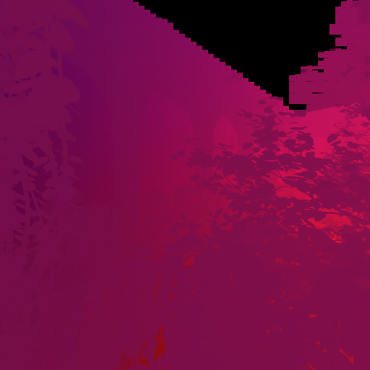

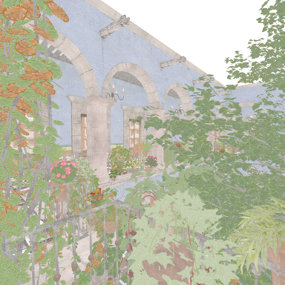

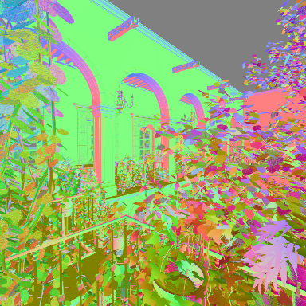
Robust Denoising using Feature and Color Information (RDFC)
Input: Color image and features
Candidate filters
Selection map
Output
Features:
Similar structure as color image
Much less noisy
NL-means & Cross-bilateral filter
Stein’s unbiased risk estimate (SURE)
[Stein 1981]
Notes:
Show zoom in: different scales are good in different region (explain what «candidate filters» are). Want to get opt. Combination of these images. ➔ estimate error...
Reveal candidate filter box, then show zoom in (text which says: «sensitive to color, sensitive to features, ignoring color» etc.
Go back to original slide
The first algorithm we implemented using Halide is the RDFC algorithm by Rousselle et al.
This algorithm denoises ordinary Monte Carlo renderings.
It takes a noisy color image as well as features as input.
In the context of rendering, by features we mean additional information about a scene which can be cheaply collected during rendering.
These can be shadows, positions of objects, textures and normals of a scene.
They are much less noisy, because their value only depends about the primary hit of a path in the scene.
The input to the algorithm is the rendered color image and a number of feature buffers.
The algorithm then works by essentially applying an edge aware blurring the noisy image.
The filtering is constrained by the color and the features.
This means that if there is a strong edge for example in the normals, the algorithm does not blur accross this edge.
The filter allows to vary the sensitivity to the information from the noisy color image and to the feature information.
These parameters can typically not be set globally optimal.
There is essentially a different optimal parameter setting at each pixel.
The optimal parameters are unfortunately unknown.
RDFC now filters the color image three times using different parameters for these sensitivities.
For each candidate filter RDFC then estimates the per pixel mean squared error.
The error is estimated using Steins unbiased risk estimate [Stein 1981], which gives an unbiased estimate of the MSE.
The error estimate is used to compute a filter selection map.
The filters are then averaged using this selection map to get a final result image.

Slide 17
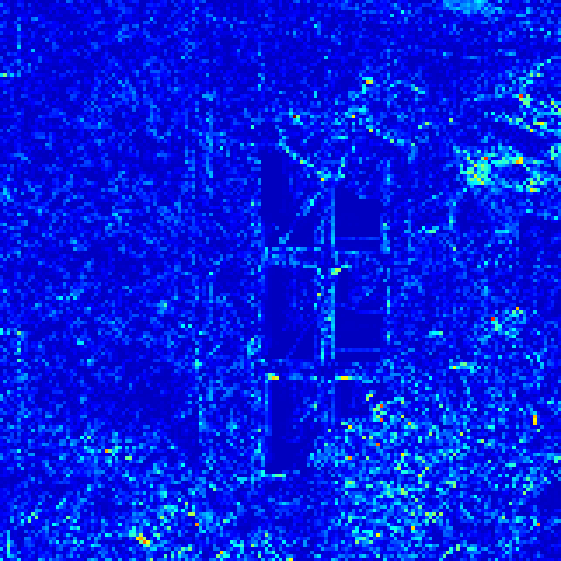
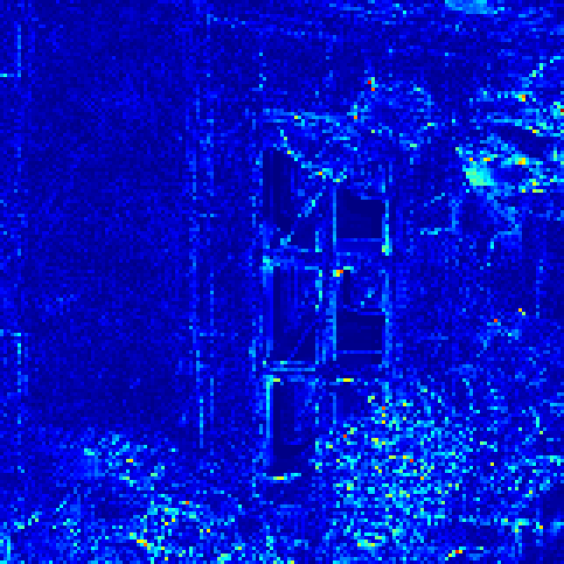
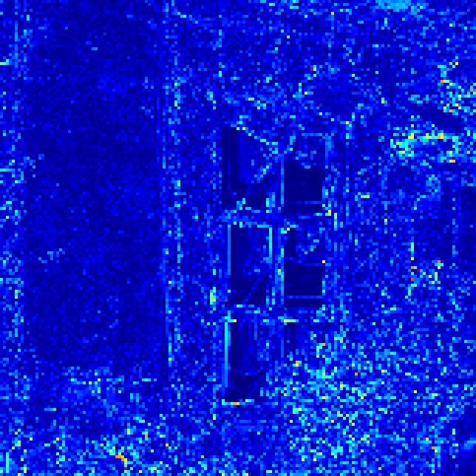
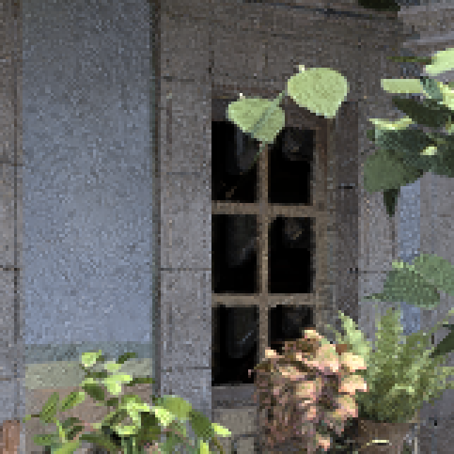
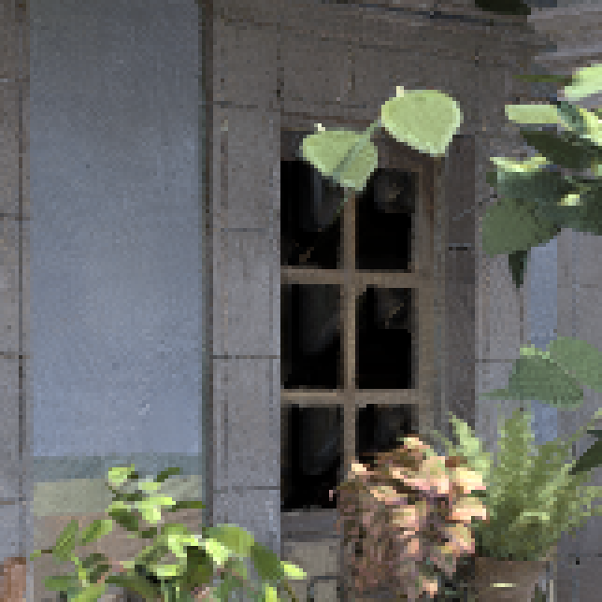
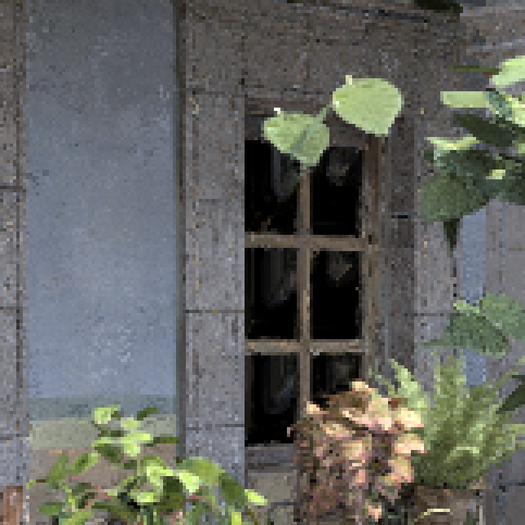
Candidate Filters
Candidate Filters
Goal: Select best candidate filter at each pixel

Slide 18

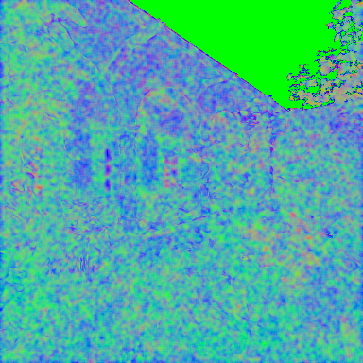

Robust Denoising using Feature and Color Information
Input: Color image and features
Candidate filters
Selection map
Output
Features:
Similar structure as color image
Much less noisy
NL-means & Cross-bilateral filter
Stein’s unbiased risk estimate (SURE)
[Stein 1981]
Notes:
Show zoom in: different scales are good in different region (explain what «candidate filters» are). Want to get opt. Combination of these images. ➔ estimate error...
Reveal candidate filter box, then show zoom in (text which says: «sensitive to color, sensitive to features, ignoring color» etc.
Go back to original slide
The first algorithm we implemented using Halide is the RDFC algorithm by Rousselle et al.
This algorithm denoises ordinary Monte Carlo renderings.
It takes a noisy color image as well as features as input.
In the context of rendering, by features we mean additional information about a scene which can be cheaply collected during rendering.
These can be shadows, positions of objects, textures and normals of a scene.
They are much less noisy, because their value only depends about the primary hit of a path in the scene.
The input to the algorithm is the rendered color image and a number of feature buffers.
The algorithm then works by essentially applying an edge aware blurring the noisy image.
The filtering is constrained by the color and the features.
This means that if there is a strong edge for example in the normals, the algorithm does not blur accross this edge.
The filter allows to vary the sensitivity to the information from the noisy color image and to the feature information.
These parameters can typically not be set globally optimal.
There is essentially a different optimal parameter setting at each pixel.
The optimal parameters are unfortunately unknown.
RDFC now filters the color image three times using different parameters for these sensitivities.
For each candidate filter RDFC then estimates the per pixel mean squared error.
The error is estimated using Steins unbiased risk estimate [Stein 1981], which gives an unbiased estimate of the MSE.
The error estimate is used to compute a filter selection map.
The filters are then averaged using this selection map to get a final result image.

Slide 19
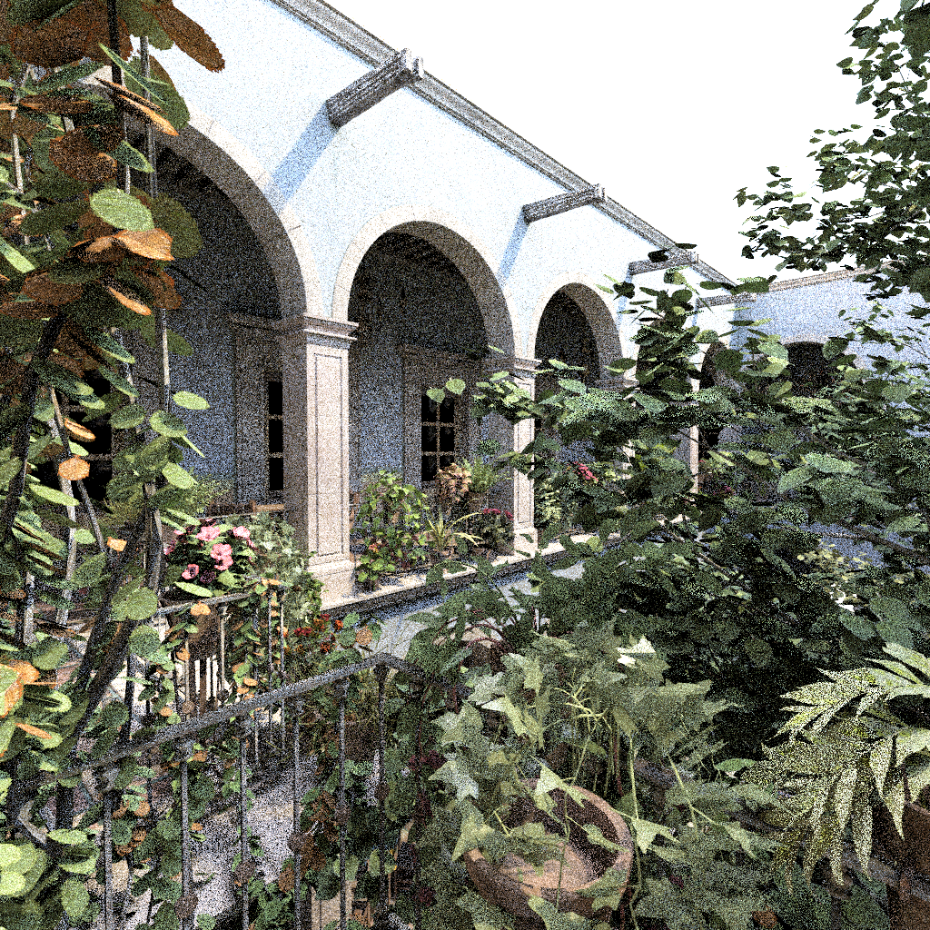

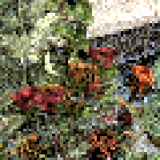
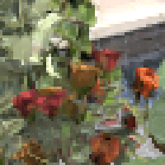
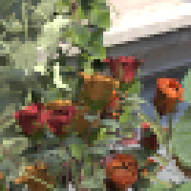
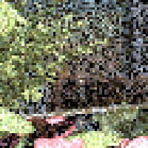
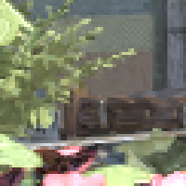
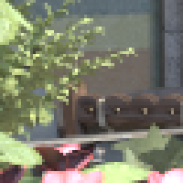
Example
Noisy image
Filter result
Noisy image
Filter result
Reference
Notes:
3.07 x 10^-2

Slide 20
Results
Timings on 1024 x 1024 image
Speedup on GPU: using shared memory and merging of kernels
Speedup on CPU: using vectorization and fast blur schedule
Original (GPU) | Halide (GPU) | Original (CPU) | Halide (CPU)
4.3 s | 3.5 s | 6.6 min | 3.0 min
Notes:
We wrote both a GPU and a CPU schedule for our RDFC implementation
Our code outperforms the previous implementations on the GPU and CPU.
The speedup on the GPU was mainly achieved using shared memory and by merging some kernels in order to keep intermediate results in registers
On the CPU, the speedup is due to vectoriztation and using the fast blur schedule from the previous code example.

Slide 21
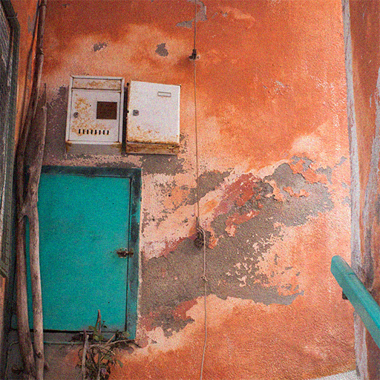

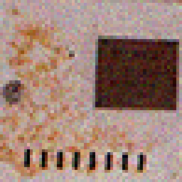
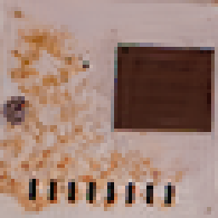
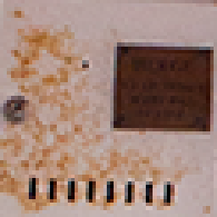
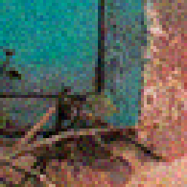

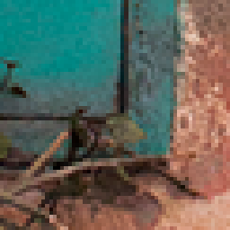
Dual-Domain Image Denoising [Knaus and Zwicker 2015]
Noisy image
Filter result
Noisy image
Filter result
Reference
Notes:
The second algorithm we implemented is Dual Domain Image Denoising.
This algorithm is a general denoising algorithm and can for example be used to denoise noisy digital photographs.
Technically it estimates the noise both in spatial and in frequency domain to get a state-of-the-art denoising result.
DDID is much simpler than other denoising algorithms with comparable quality.
1.8 x 10^-3

Slide 22
Results
Timings on 512 x 512 image
Would need to manually implement Fast Fourier Transform using Halide for further speed up
Original (Matlab CPU) | Halide (GPU) | Halide (CPU)
1.5 min | 7 s | 3.5 min
Notes:
Find nicer way to present timings, like a table maybe

Slide 23
Conclusion to Part I
We were able to outperform the existing implementations of RDFC and DDID
Performance is competitive to raw C++/CUDA
Optimizing code using Halide is fast and easy
Not a full replacement of CUDA/OpenCL, not all GPU features usable (streams, textures, atomic operations, intra warp operations, … )
Still a few bugs, but very active development and support
Unique combination of high performance and portability
Notes:
Overall we managed to outperform the existing implementations of both algorithms
Halide code can beat the performance of C++ code even though it abstracts many things
Optimizing code using Halide is fast and easy also for more complex code than a box blur
Note, that since Halide is an abstraction of the underlying hardware, it also has a few limitations
In the context of GPU programming, it does not allow you to use streams, textures, atomic operations and intra warp operations.
The two algorithms we implemented did not require these kind of features, but thats certainly something one should consider before working with halide.
Its also important to mention that there are still a few bugs. Halide is still quite a new technology.
Halide should currently not be used
the code only needs to run on one machine in the lab
Performance is not a huge issue or optimization trivial
when working under tight deadlines (still some bugs...)
Halide should be considered when
performance is very important
portability is required

Slide 24
Content
Part I: Image Filtering using Halide
Part II: Denoising for Gradient-Domain Rendering

Slide 25
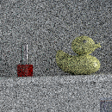
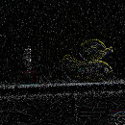






Gradient-domain rendering
[Lehtinen et al. 2013, Manzi et al. 2014, Manzi et al. 2015, Kettunen et al. 2015]
Base image
Sampled gradients
Reconstruction
Poisson solver
Gradients can be sampled with low variance
Unbiased, less variance than naive path tracing!
Notes:
Gradient-domain rendering algorithms essentially work by sampling a noisy base image like conventional path tracing algorithms.
This base image has strong high frequency noise.
Simultaneously we also sample image space gradients in x and y directions.
Reconstruction: high frequency from gradients, low frequencies from base image. Gradients less noise => less noise in reconstruction

Slide 26





Screened Poisson Solver
Image reconstructed by solving Poisson problem:
➔ Least squares problem
Controls importance of base image
Image should be close to base image
Image gradients should be close to sampled gradients
and are finite difference operators
Notes:
(give equation, explain the different terms (introduce some notation already on the previous slide))
Build up equation piecewise. Image , gradients, alpha

Slide 27


L1-Reconstruction
In practice: problems with conflicting gradient information
L2-norm
(unbiased)
L1-norm (biased)
Notes:
Quickly show L1 vs L2 and non-zero curl or conflicting gradients problem

Slide 28
Noise in Reconstruction
Nice, but still far from perfect...
Notes:
Show artifacts still present in gradient domain rendering
Really the right comparison?

Slide 29




Extending the Reconstruction
Goal: Make reconstructed image piecewise smoother by adding additional constraints
Features are locally very smooth
New constraint
...
Normals
Textures
L1-reconstruction
Notes:
Make reconstructed image piecewise smoother by adding additional constraints
Features are usually very smooth (show reconstructed image (L1), next to it smooth features (crops, duck)). Also note that features capture most of the important scene details.

Slide 30














Extending the Reconstruction
Vectors spanning the local feature subspace
≈ weighted
sum of:
?
3 channels
1 channel
3 channels
Unknown image
Features

Slide 31


Extending the Reconstruction
Close to a weighted sum of vectors close to the subspace spanned by these vectors
We want:
➔ Need to minimize patch constraint term for each pixel :

Slide 32

Extending the Reconstruction
New optimization problem:
Still a least squares problem
How useful are our new constraints? Is the converged image actually locally close to a weighted sum of feature vectors?

Slide 33

















Problems
Reconstruction not consistent!
Converged image
Projection onto feature subspace
Converged image
Local feature vectors
Notes:
Ideally, the converged image should be locally exactly the sum of local feature patches.
For some regions this makes sense
For others not so much
Makes filter not consistent!

Slide 34
Constraint weights
Solution: Add constraint weights for each pixel:
Weights get more restrictive as variance decreases: filter is consistent
Not important to fit
.*
Important to fit
Error for each
pixel in a patch

Slide 35












Pipeline
Input: Base image, gradients and features
Candidate filters
Selection map
Output
[Bauszat et al. 2015]

Slide 36
Results
Computing three candidate filters takes around 30 s using CUDA
Our filter reduces MSE by a factor of 2 to 4 in practice
Notes:
Show nice results
Compare 4x BDPT, correct L1,

Slide 37

Results
L1-reconstruction

Slide 38

Results
Our reconstruction

Slide 39




Results
BDPT
512 spp
0.070
G-BDPT L1 128 spp
0.018
G-BDPT OUR 128 spp
0.005
Reference
Notes:
Todo: RMSE (full, no inset)

Slide 40

Results
L1-reconstruction

Slide 41

Results
Our reconstruction

Slide 42




Results
BDPT
512 spp
0.079
G-BDPT L1 128 spp
0.034
G-BDPT OUR 128 spp
0.011
Reference
Notes:
Todo: RMSE (full, no inset)

Slide 43

Results
L1-reconstruction

Slide 44

Results
Our reconstruction

Slide 45




Results
BDPT
64 spp
0.128
G-BDPT L1
16 spp
0.024
G-BDPT OUR 16 spp
0.006
Reference
Notes:
Todo: RMSE (full, no inset)

Slide 46
Conclusions to Part II
We presented new regularization constraints for the screened Poisson reconstruction, which reduce noise in the reconstruction
Our denoising algorithm is 2 to 4 times better than the L1-reconstruction
We showed, that our algorithm can be efficiently implemented on the GPU

Slide 47
Future work
Adaptive patch constraints: adaptively change patch size, patch constraints not for every pixel
Denoise features (similar to RDFC)
Filtering of animations
Compressive rendering applications of patch constraints
...
Notes:
Increase solver speed by preconditioning the constraint matrix

Slide 48
Questions?

Slide 49

Patch constraint weights
Color weights:

Slide 50


Patch constraint weights
Feature weights:
Final weights:

Slide 51









Error estimation [Bauszat et al. 2015]
Candidate filters
Sparse reference
Sparse error
Interpolated error
Selection map
Notes:
Show pipeline and explain each step. Keep this very short (can use same pipeline images as in thesis, slightly modified for display)

Slide 52



Extending the Reconstruction
Close to a weighted sum of vectors close to the subspace spanned by these vectors
Compute basis of the local feature subspace by orthogonalizing feature vectors
Projection of local patch onto feature subspace:

Slide 53

Extending the Reconstruction
We want:
➔ Need to minimize patch constraint term for each pixel :
Identity matrix

Slide 55


Extending the reconstruction
Motivation: Using sparsity constraint similar to denoising using overcomplete dictionaries [Elad and Aharon 2006]
Initial idea: reconstructed image should be equal to a sparse combination of basis vectors constructed from the features
where is an overcomplete basis
➔ not feasible to globally solve for the reconstructed image
Notes:
Dictionaries not feasible: global optimization leads

Slide 56


Extending the reconstruction
Add constraint weights for each pixel :
Diagonal matrix weights importance of patch constraints at individual pixels
Weights decrease when variance decreases: filter is consistent
Constraint weights

Slide 57
Extending the reconstruction
Compute basis of the local feature subspace by orthogonalizing feature vectors
Projection of local patch onto feature subspace:
Notes:
Write Gamma_k I as «patch_k(I)» (as function instead of matrix mult)
SWITCH ORDER, do not mention SVD

Slide 58
Implementation using CUDA
Solve least squares problem iteratively by using conjugate gradient method (CG)
Based on the CUDA code of the original gradient-domain rendering paper [Lehtinen et al. 2013]
Our reconstruction: ≈10 s for a 1 mega-pixel image and patch radius of 2 (on a NVIDIA GTX Titan X)

